Slide 1
Distributed Schema
for Chat Application
Team No : 51
Sk Abukhoyer 2021201023 Sourav Kumar Singh 2021201072
Akilesh Panicker 2021201081 Debjani Mallick 2022801019

Slide 2
Distributed Chat Application
Design Goal :
Designing a realtime distributed chat application which is highly scalable and fault tolerant.
Servers must be scalable and multiple web-server instances should be present behind the load balancer.
Technologies Used:
NodeJs, React, Socket.io, redis, haproxy, mongodb.

Slide 3
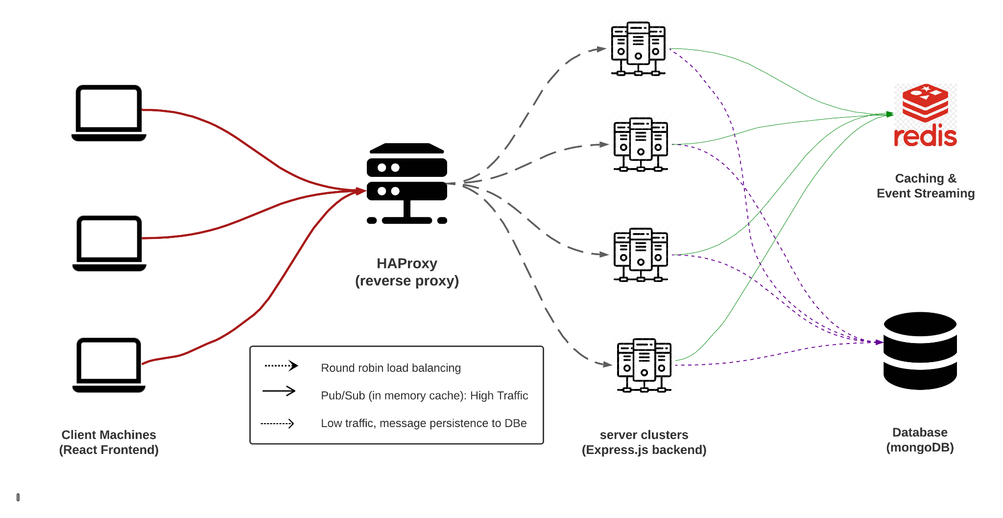
Architecture

Slide 4
Design Challenges for Distributed Chat Application
Real Time Synchronization:
Backend servers are load-balanced by a reverse proxy, using round-robin scheduling to distribute incoming requests evenly across the available nodes.
Clients connected to different nodes must be aware of new events in real-time, such as online users, rooms, messages and new users joining the chat.
The system uses a publisher/subscriber design pattern, with four different topics for four different types of events.
By using haproxy, we ensure that the system is easily scalable, highly available, and fault-tolerant.

Slide 5
Design Challenges for Distributed Chat Application
Publisher / Subscriber Design:
Each node in the system is both a subscriber and a publisher, ensuring that all nodes are aware of all events.
When an event is published in a topic, all nodes are immediately notified and the events are synchronized across the system.
Persistence:
The system uses different persistence mechanisms for different types of data:
Metadata about rooms and users is stored in Redis.
Chat messages are stored in MongoDB.

Slide 6
Functionalities of the Distributed Chat Application
The system enables users to communicate through various messaging types, such as personal messaging and group messaging.
Full data persistence is provided by the system, allowing users to retrieve their chat history from the past whenever necessary.
The system also offers real-time information about active room’s users and users, allowing users to monitor who is online and follow ongoing conversations.

